Slide 1
Iteration 3 Sequence Diagram

Slide 2
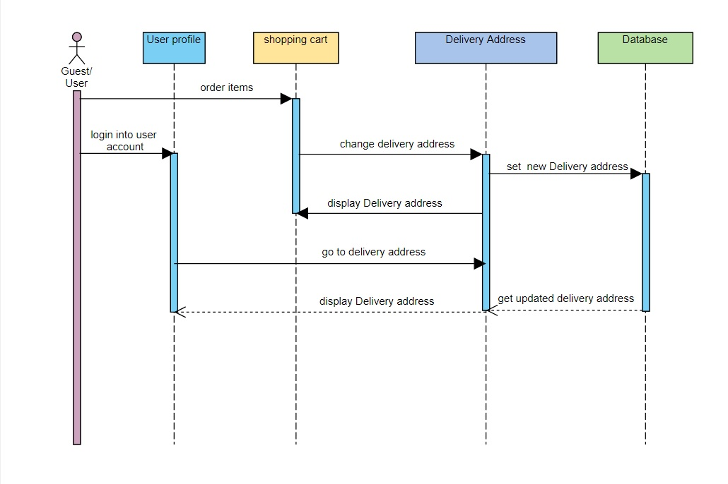
3.02 change delivery address

Slide 3
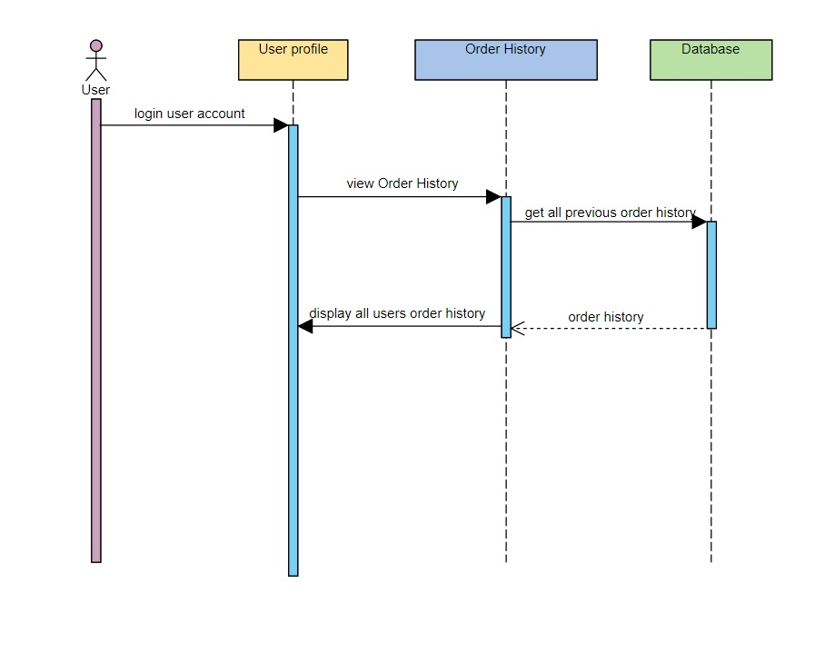
5.07 Order history

Slide 4
Class Diagram

Slide 5
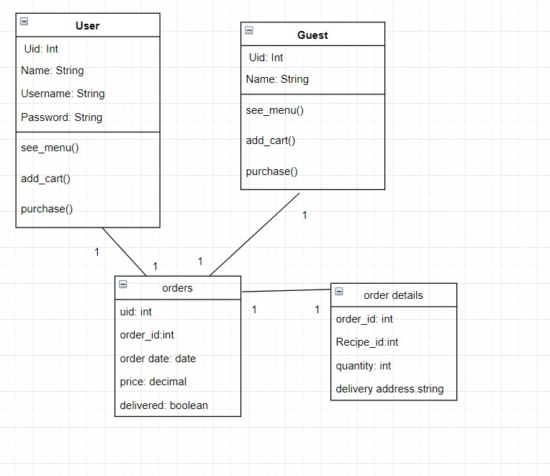
3.02 change delivery address

Slide 6
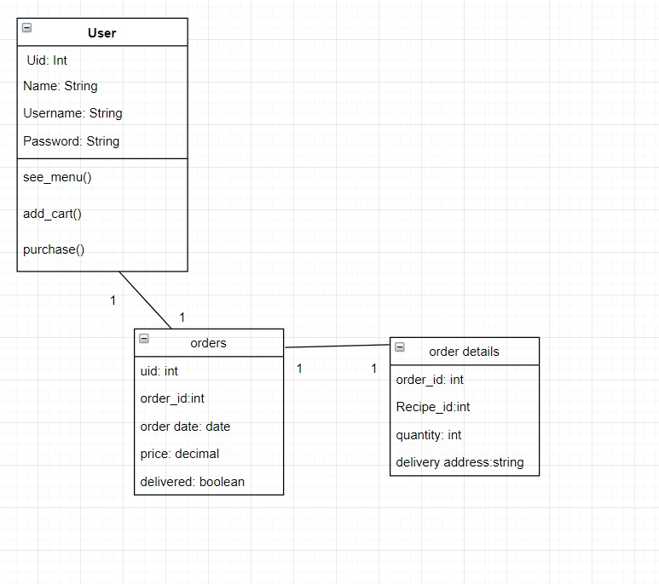
5.07 Order history.

